Slide 1
The Discrete Fourier Transform (DFT) in the Context of Digital Signal Processing
Jeff Arena
July 13, 2020

Slide 2
What is Digital Signal Processing?
Signal
Any quantity whose value may change over a given domain (this domain is often time or space)
Examples:
amplitude vs. time in sound waves
brightness vs. height in an image
stock price vs time in the stock market
Digital Signal
A signal which is discrete in amplitude and time (e.g., any signals stored on a computer are digital)
Digital Signal Processing
A sub-discipline (typically of electrical engineering) encompassing various mathematical tools useful for analysis, modification, and synthesis of digital signals

Slide 3
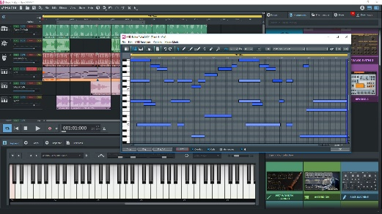




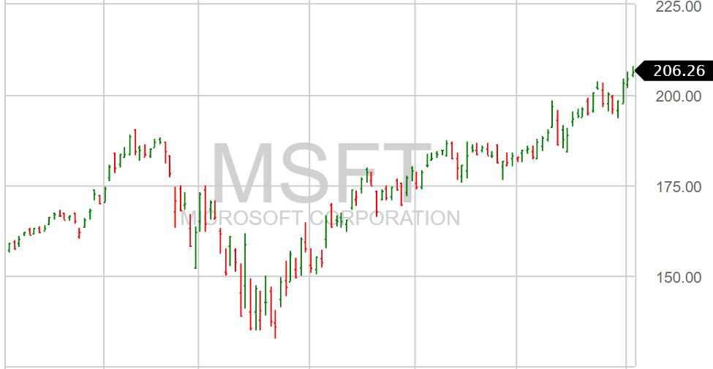

Example Applications of Signal Processing
Audio
Image
- Music composition (e.g. filtering, compression)
- Active noise cancelation
- Digital cameras (e.g. image stabilization)
- Photoshop (e.g. filtering, enhancement)
Biometric
Stock Trading
- Facial / voice recognition
- Analyzing stock market trends

Slide 4
Where Does The Discrete Fourier Transform Fit Into Digital Signal Processing?
Signal Processing
(Analog) Signal Processing
(more theoretical)
Digital Signal Processing
(more experimental)
Continuous Fourier Transform
Laplace Transform
Discrete Fourier Transform
Z - transform
Focus
Discrete Fourier transforms are an integral tool within digital signal processing, but only one aspect of the larger theory of signal processing

Slide 5
Outline
Introduction
Mathematical Description
Examples (Intuition Building)
Connection to Machine Learning

Slide 6
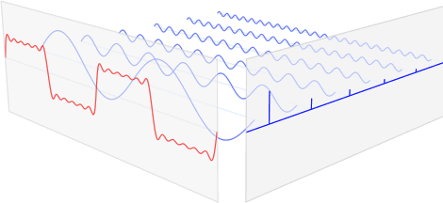
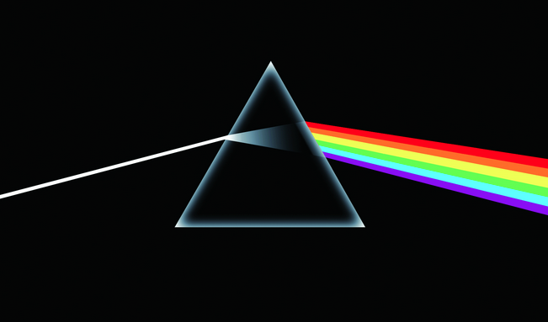
What Does a Fourier Transform “Do”?
The discrete Fourier transform takes a signal in the time domain, and determines which frequencies (of sine / cosine waves) comprise it
The Fourier transform of a signal can be referred to as its “frequency content” or “spectrum”
Frequency Components of a Time-Domain Signal
The Fourier Transform is Analogous to a “Mathematical Prism”
Time Domain
Frequency Domain

Slide 7
Mathematical Prerequisite: What is ?
In turns out, if we define a new number, it is useful (more accurately, essential) in performing Fourier transforms
The number is called ‘ ’ and it is defined by the following equation:
From this definition and some calculus, one can derive Euler’s formula, which is an integral part of the Fourier transform
Because of we can transform a function of time into the frequency domain and retain information about both the phase and amplitude of the constituent sine waves
The concept of is thus very useful mathematically (its existence is left as a philosophical question)

Slide 8
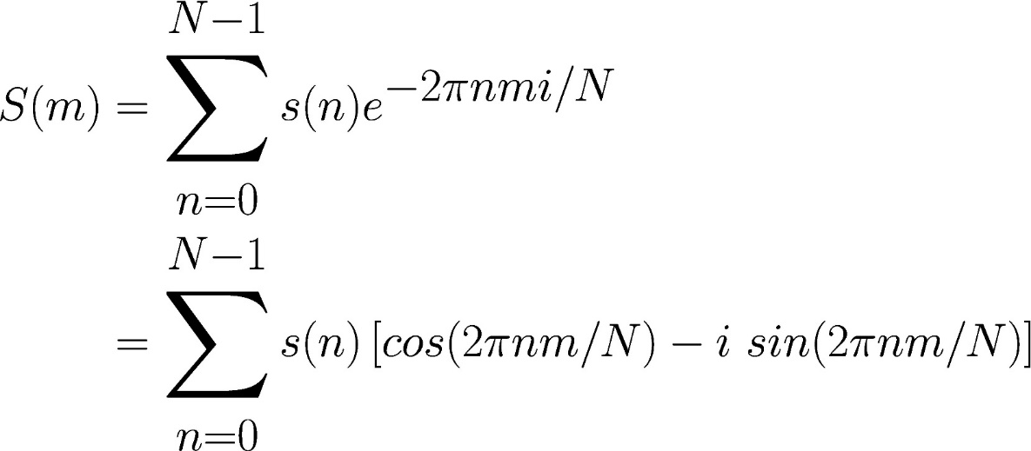
Discrete Fourier Transform: Definition
†
(We substitute using Euler’s formula)
The discrete Fourier transform (DFT) transforms an N-point signal in one domain (usually time) to an N-point signal in another domain (usually frequency)
†Assume N is odd for this example, although similar math holds for even N
Notes:
\text{Let $s(n)$ be a signal defined for integers $n$ in the interval $[0,N-1]$}
\text{Define a function $S$ for $m$ in the interval $[-(N-1)/2,(N-1)/2]$}
S &\equiv \mathcal{F}(s) \\
S(m) &= \sum\limits_{n=0}^{N-1} s(n) e^{-2\pi n m i /N} & \text{for all } m \in [-N/2, N/2]\\
&= \sum\limits_{n=0}^{N-1} s(n) \left[ cos(2 \pi n m/N ) - i \ sin(2 \pi n m/N) \right]
Potentially introduce Euler’s formula in its own slide

Slide 9
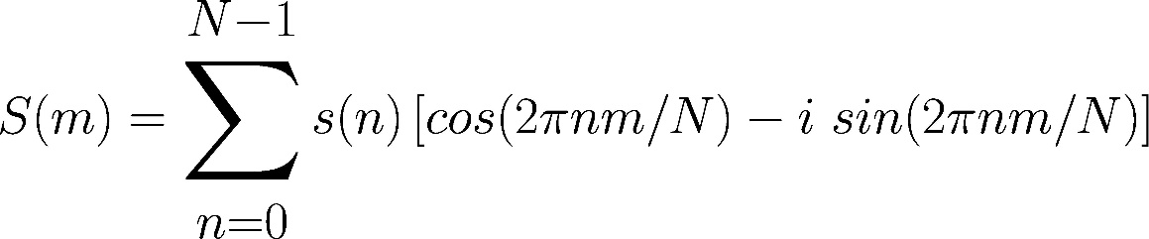
Discrete Fourier Transform: Intuition
These signals repeat m times over the input time interval
This sum* will be highest if s(n) has patterns that repeat m times over the time interval
The mth term in the discrete Fourier transform quantifies how “similar” the signal is to basic sine and cosine waves of a single frequency**
By calculating the value of S(m) for all m, we can determine the spectral contents of the signal
*This comparison of two signals is a special case of a concept called “cross correlation” **The frequency that completes m cycles over all samples
Discrete Fourier transforms are an integral tool within digital signal processing, but only one aspect of the larger theory of signal processing
Notes:
\text{example signal: } s(n) = sin(2 \pi (\frac{n}{4}) + 0.5 \ sin(2\pi \frac{n}{8})

Slide 10
Outline
Introduction
Mathematical Description
Examples (Intuition Building)
Connection to Machine Learning

Slide 11
Example: Single Sine Wave
DFT*
IDFT**
Pure sine (or cosine) waves in the time domain appear as narrow peaks in the frequency domain centered at the sine wave frequency
*Discrete Fourier Transform **Inverse Discrete Fourier Transform
Notes:
18 46 71
77 35 7

Slide 12
Example: Sum of Sine Waves
DFT*
IDFT**
The sum of sinusoidal functions in the time domain, appear as multiple individual peaks in the frequency domain (one per sinusoid)
*Discrete Fourier Transform **Inverse Discrete Fourier Transform
DFT
DFT

Slide 13
Example: Sum of Sine Waves (continued)
We usually don’t know what comprises a signal we are sampling
DFT*
IDFT**
The sum of sinusoidal functions in the time domain, appear as multiple individual peaks in the frequency domain (one per sinusoid)
*Discrete Fourier Transform **Inverse Discrete Fourier Transform
DFT
DFT

Slide 14
A Word of Caution on “Undersampling”
Nyquist criterion†: signals must be sampled at twice the highest present signal frequency to avoid “false” frequencies (so called “aliases”) appearing in the Fourier transform
DFT*
IDFT**
*Discrete Fourier Transform **Inverse Discrete Fourier Transform
†The “Nyquist rate” is often used to denote the minimum sample rate for alias-free signal sampling
DFT
DFT

Slide 15
A Word of Caution on “Undersampling”
Nyquist criterion†: signals must be sampled at twice the highest present signal frequency to avoid “false” frequencies (so called “aliases”) appearing in the Fourier transform
DFT*
IDFT**
Sampling a periodic signal less than twice per cycle will not correctly capture its spectral content
The apparent spectral content of an undersampled signal will contain alias frequencies that are not present in the input
*Discrete Fourier Transform **Inverse Discrete Fourier Transform
†The “Nyquist rate” is often used to denote the minimum sample rate for alias-free signal sampling
DFT
DFT

Slide 16
Outline
Introduction
Mathematical Description
Examples (Intuition Building)
Connection to Machine Learning

Slide 17
The Discrete Fourier Transform: a Source of Signal Features
In general, machine learning relies on identifying useful features in each sample to make accurate predictions
Examples:
- Accepting/rejecting loan applications based on past behavior
- Estimating home price based on attributes of neighborhood and home
- Identifying people in images using geometric aspects of their faces
To classify data that is in the form of a signal, frequency content can be an indispensable source of features!
Anecdotally, think about when you remember your favorite song, is it based on individual samples? Or the frequency content (i.e. the musical tones) present?
The discrete Fourier transform provides access to the frequency content of a signal, which can enable machine learning algorithms to make more accurate predictions

Slide 18

Example: Music in The Frequency Domain

Slide 19
Example: Music in The Frequency Domain
Peaks occur at the notes in the C major scale!
C4 (262 Hz)
E4 (330 Hz)
A2
(110 Hz)
C3
(131 Hz)
A3
(220 Hz)
D4 (294 Hz)
G3
(196 Hz)
D3
(146 Hz)
F3
(175 Hz)
Viewing signals in the frequency domain can yield useful features for classifying a signal

Slide 20
Example: Music in The Frequency Domain
What if we want to know when notes are played? (not just what notes are played?)
DFT

Slide 21
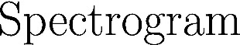
Example: Music in The Frequency Domain
What if we want to know when notes are played? (not just what notes are played?)

Slide 22
Example: Music in The Frequency Domain
A-minor
C-major
D-major
F-major
Spectrograms apply discrete Fourier transforms to shorter segments of the signal to reveal changes in the frequency content over time

Slide 23
Summary
The discrete Fourier transform (DFT) and its inverse are fundamental mathematical tools used in digital signal processing—enabling analysis of a signal’s frequency content
Signals which are sampled in the time domain can be decomposed as the sum of sine and cosine waves of varying amplitudes, frequencies, and phases
Provided the Nyquist criterion is satisfied in sampling a signal, the sinusoidal components of that signal will appear as peaks in the frequency domain at the input frequencies
Discrete Fourier transforms can provide a valuable source of features when applying machine learning algorithms to signal data

Slide 24
Addendum: DFT Leakage
What happens if time domain signal has frequency that doesn’t fall precisely into a DFT bin?
DFT*
IDFT**
When sine wave frequency doesn’t fall into a DFT bin, spectrum will “leak” into other bins
Peak of DFT still occurs at frequency of sampled sine wave

Slide 25
Example: Sum of Sine Waves (cont’d)
DFT
DFT
DFT
DFT
DFT
IDFT
The discrete Fourier transform of a sum, is also the sum of the Fourier transforms
DFT*
IDFT**

